Slide 1


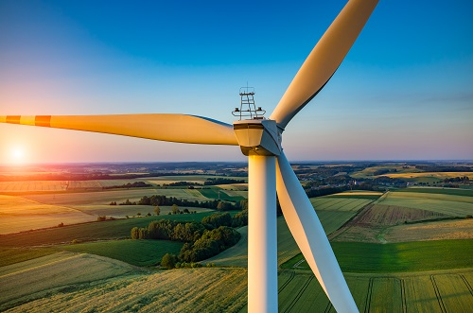
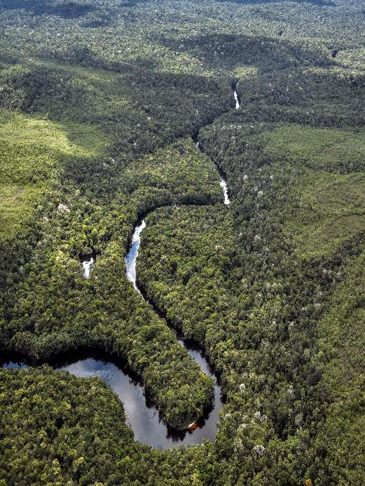

New York Green Team – Modal Shift
Environmental Sustainability
May, 2019

Slide 2

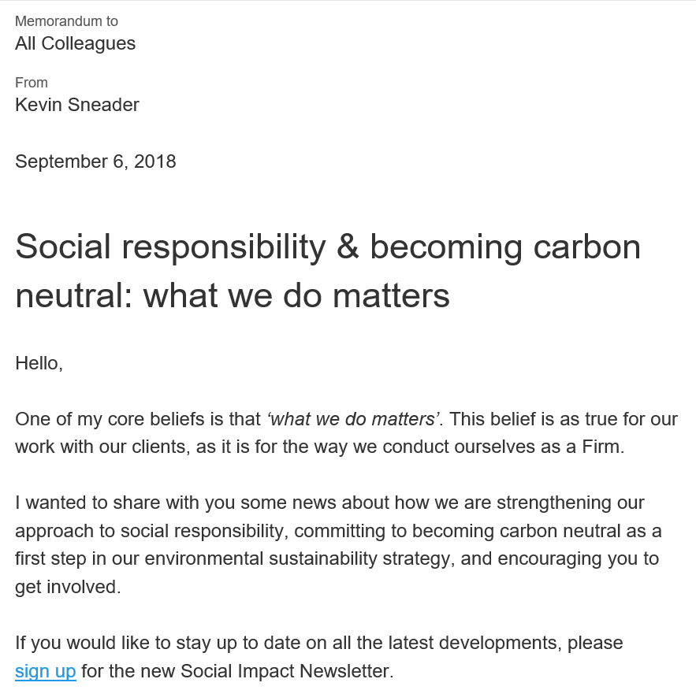



CONTEXT
Our Firm has recently made public commitments to reduce our emissions, to purchase renewable electricity and to become carbon neutral
Memo from Kevin Sneader
Our public commitments
Reduce our GHG emissions 60% by 2030 and 90% by 2050 (for direct emissions and purchased energy) – in line with the New York Agreement
Purchase 100% renewable electricity and join the RE100 coalition
Become carbon neutral by the end of 2018, offsetting emissions we cannot reduce¹
Firm leadership (e.g. our Managing Partner, Shareholders Council) has recently strengthened our Firm’s environmental strategy, which will enable us to better address our environmental impact.
1 We achieved Climate Neutral Company status in December 2018
SOURCE: Global Social Responsibility

Slide 3
~80% of our Firm’s carbon footprint is due to Air Travel, offering the biggest opportunity to reduce emissions
CONTEXT
Total emissions¹ by source (2017), ktCO2e
Total
Scope 3
Scope 2
Scope 1
779
We fly to the
moon and back
~7x a day
625
46
32
32
28
9
7
Total
Air travel
Hotels
Taxi/car rental
Other
Electricity
Heating
Owned/ leased cars
1 Includes all emission sources required for South Pole’s carbon neutral label, including WTT and RF index for flights
SOURCE: Global Social Responsibility

Slide 4



A key lever to reduce emissions for air travel is a modal shift from Air to Rail – significant potential exists for NY-Washington
AIR TO RAIL MODAL SHIFT
DIRECT (OWN) BOOKINGS NOT INCLUDED,
HENCE UNDERESTIMATING RAIL JOURNEYS
New York-Washington itinerary
Number of journeys, 2018
Savings potential
Hours, USD, kg CO2e
Share of journeys in total, %
Increasing the share of Rail to 90% can save...
8,751
Travel time^{1,2},
h:mm
3:10
3:45
+0:35
6,526
productive hours³
Flights
63%
Average ticket price
USD
-1 $
1
kUSD
GHG emis-sions
kg CO2e
Train journeys
37%
-104 kg CO2e
478
tons CO2e
1 Total flight travel time = commute to airport (30 min) + pre-departure time in airport (45 min) + flight time + arrival time in airport (20 min) + commute to final destination (30 min)
2 Total train travel time = commute to station (20 min) + pre-departure time in station (15 min) + train time + arrival time in station (5 min) + commute to final destination (20 min)
3 Calculated using the delta in productive hours between plane and train, assuming for productive time for the flight: (20 mins during the commute and pre-departure time) + (flight duration -25 mins of takeoff and landing time); assuming for productive time for the train: (train duration - 5 mins)
SOURCE: Global Airline Program Oct 1, 2017 - Sep 30, 2018; South Pole; Global Social Responsibility

Slide 5

Modal shift from Air to Rail – New York-Washington customer journey
PRELIMINARY
Book travel
Commute to airport/train station
Check-in/ customs/security
Travel
Pick up luggage/ customs
Commute to client/hotel/office
Total travel time
1
2
3
4
5
6
Air travel
Duration
3:10
0:30
0:45
1:20
0:20
0:15
Detail
Ticket is booked through local AmEx agency
Commute from McK New York office to la Guardia airport takes about 0:30 by taxi
In order to proceed through security in a timely manner, arriving 0:45 before departure is the minimum
Fly time between New York and Washington is about 1:20
Upon arrival, walking to the exit, proceeding through customs and finding a cab takes minimum 0:20
Commute from Washington airport to McK Washington office takes at least 0:15
Rail
Duration
2:50
3:45
0:15
0:15
0:05
0:20
Detail
Ticket is booked through local AmEx agency or by Firm member and later expensed
Commute from McK New York office to Penn station takes maximum 0:15 by metro
In order to board the train in a timely manner, arriving 0:15 before departure is plenty
Rail time between New York and Washington is about 2:50
Upon arrival, walking to the exit and finding a cab/subway takes 0:05
Commute from Union station to McK Washington office takes 0:20 by taxi
How to achieve Modal Shift?
Rethink travel desk processes and training (e.g. standardized scripts); at the moment, travel agents typically book whatever they are asked to book, without offering alternatives such as a rail connection
Convey message that commuting to and from rail station takes significantly less time than commuting to the airport
Communicate that travelling by rail effectively shifts unproductive commuting and waiting time (to, from and in airport) to stationary time in the train that can be spent productively (e.g. working on a laptop or in calls)
Stress that number of high-speed rail connections per day is significantly higher than the number of flight connections
Travel time is similar by train, with added benefits of
Reduced cost
Increased productivity
Reduced environ-mental impact
SOURCE: Environmental Sustainability team

Slide 6
How can Green Teams help in driving a modal shift on selected routes?
INTRODUCTION
AIR TO RAIL MODAL SHIFT
Objective
How Green Teams can help
Audience
Office Leadership
Push volume from Air to Rail to reduce CO₂e emissions
Present fact pack with route(s) with significant potential for modal shift, highlighting the savings potential in time, cost and CO2e emissions
Propose to rethink travel policies (e.g., only allowing flights with ED approval) and travel scripts (e.g., offering the train as a first alternative) on selected route(s)
Peers
Build awareness and communicate benefits of the train (e.g., time savings, productivity increase, reduced environmental impact, loyalty programme) in the office and among other colleagues using posters and e-mail campaigns
Advocate the use of the train in peer group (e.g., CST, cohort)
Act as role model taking the train on the proposed routes
Do you have additional ideas – tailored to your local office context – on how to drive modal shift?
SOURCE: Global Social Responsibility

